Slide 1
AIML Solution Building TEAM 11 THEME – Health Care Payer/ Health Insurance Space in USA Market
29 Sept, 2020

Slide 2
Introduction
Sadiq Nabi - Symbiosis Centre for Management and Human Resource Development
Abhishek Negi - Malla Reddy College Of Engineering And Technology
Aravind Krishnan - National Institute Of Technology Puducherry
Meenakshi Dasgupta - Ta Pai Management Institute
Wonderful experience in working with a team with such diversity. Wonderful learning experience. Fruitful interactions with all the Virtusa business leaders and our mentor.
Will always be grateful to Virtusa for allowing me to explore the exponentially growing computational power of AI and triggering my inquisitive brain cells for data science domain.
Dear Virtusa Team, It was really a great learning experience for all of us.
I would like to place my words of gratitude for giving me an opportunity to work in a challenging and innovative project with Virtusa.

Slide 3
Problem Statement
Healthcare Provider Management – Provider Services
Build an AIML-driven model for intelligent promotion of contracts
Segmentation of different types of providers
Provide offers using predictive / adaptive algorithms
Build better partnership with providers and assist each other
AIML-powered analytics-driven proposal
Extract and capture determinants and factors that can convince a non-par provider to become a par-provider

Slide 4


Functional View
No Offer / Par-Provider Offer
Gather Provider Information
Payer
Non-Par Provider
Provider Data
Prediction
Model / UI
Contract
Provider related data for Model Building

Slide 5
Design Details
1
2
Data Exploration and Visualization
3
Model Building
4
Prediction and Deployment
Data Preprocessing
Software/ Tools Used:
Excel
Python
Tableau
Figure: Overall Process followed
Techniques used:
MICE (Data Imputation)
One Hot Encoding
Create Model
Plot Model
Predict Model
Save Model
Missing Data Analysis
Categorical Values
Data Normalization
Dimensionality Reduction
Figure: Data Pre-processing steps followed
Figure: Model Steps followed for Unsupervised Clustering

Slide 6
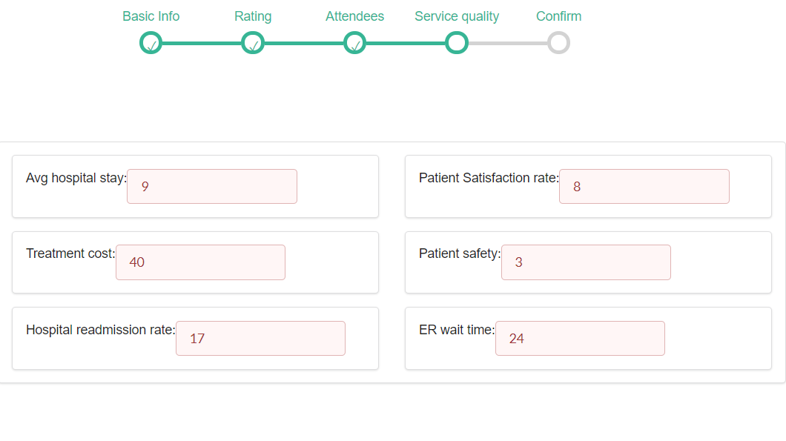
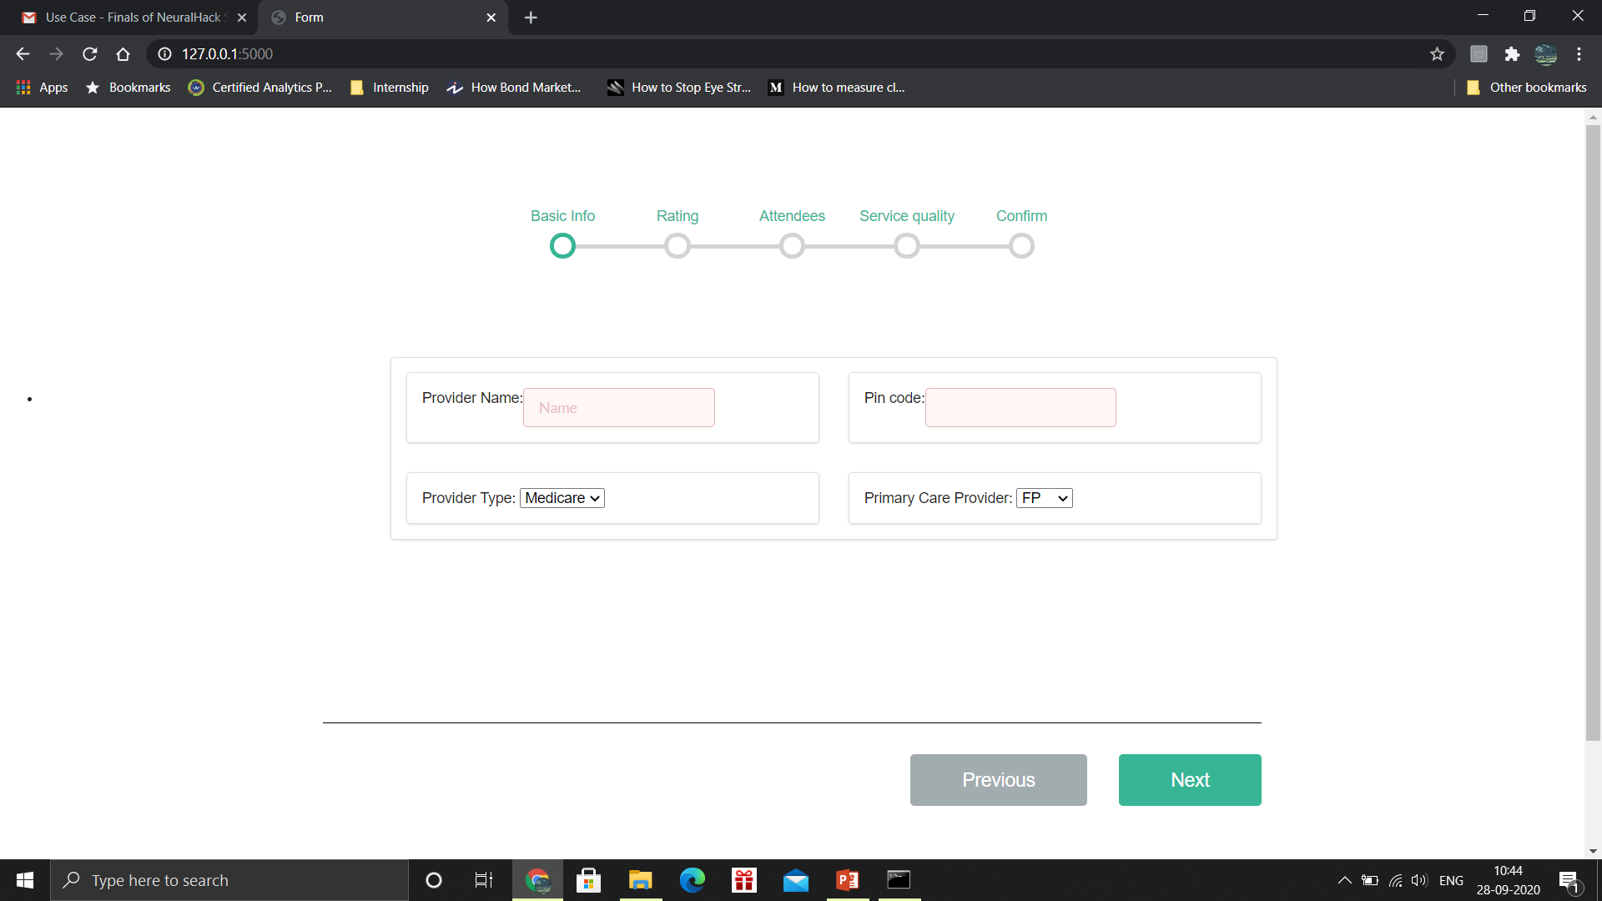
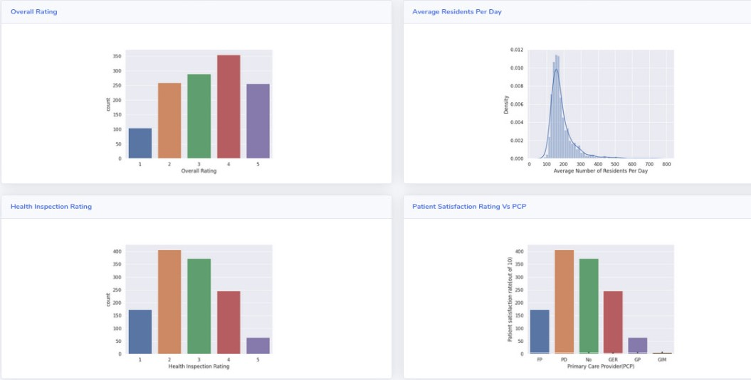
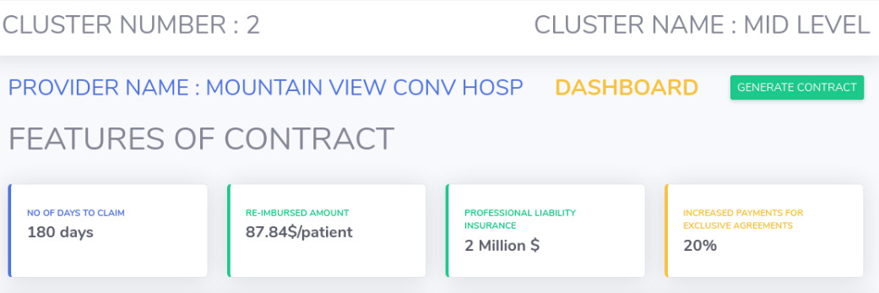
Demo Application

Slide 7
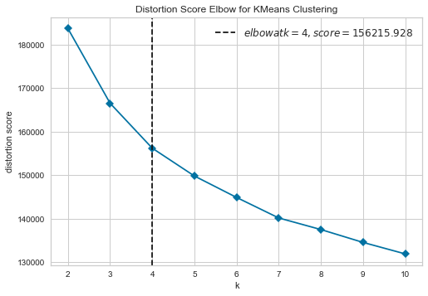
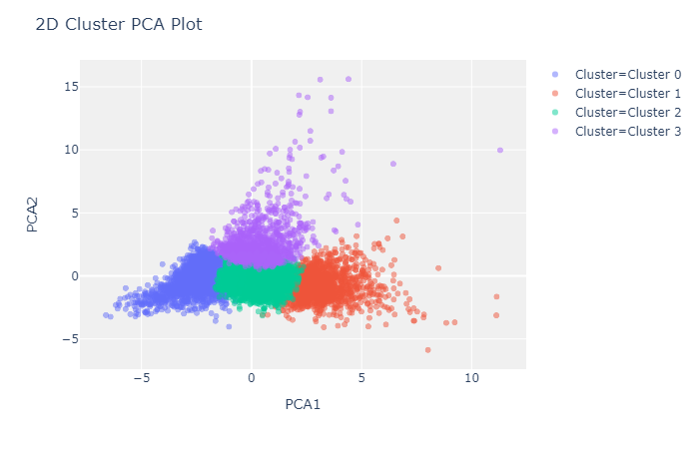
Conclusion
An AIML prototype was built for providers
Unsupervised clustering
Number of clusters : 4
KMeans clustering over Hierarchical clustering
Cluster 3 :
highest average of overall rating, cost, staff rating,
physical therapist and nurse staffing hours
least average of penalties, substantiated complaints
No Contract for Cluster 0
Cluster 0 :
highest average of penalties, substantiated complaints
lowest average of overall rating, cost, staff rating,
physical therapist and nurse staffing hours

Slide 8
Thank You

